Slide 1
Picture books:
Intro:
Virginia Lee Burton: The Little House (gets at change over time)
To go with slide #3:
Natalie Kinsey Warnock’s: The Bear that Heard Crying –this is a link to a PDF of the book
Diana Appelbaum: Giants in the Land -link to the PDF
Natalie Kinsey Warnock: Wilderness Cat -link to PDF
To go with slide #4/5
Donald Hall: Ox-Cart Man
I have used the following slides with kids to help them understand “why sheep?” and the concept of landscape change. When I do this, I use visual thinking strategies. They slowly begin to see that the slides #3,4, and 8 are of the same plot of land.
I print these and after we go through them, ask them to lay them all out and tell the story of the land.

Slide 2
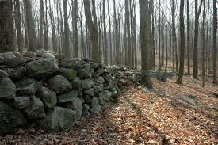
Change in the
New England Landscape
Notes:
Stone walls in the woods today– Have you ever seen stonewalls in the woods? Have you wondered why they are there? Who built them?

Slide 3
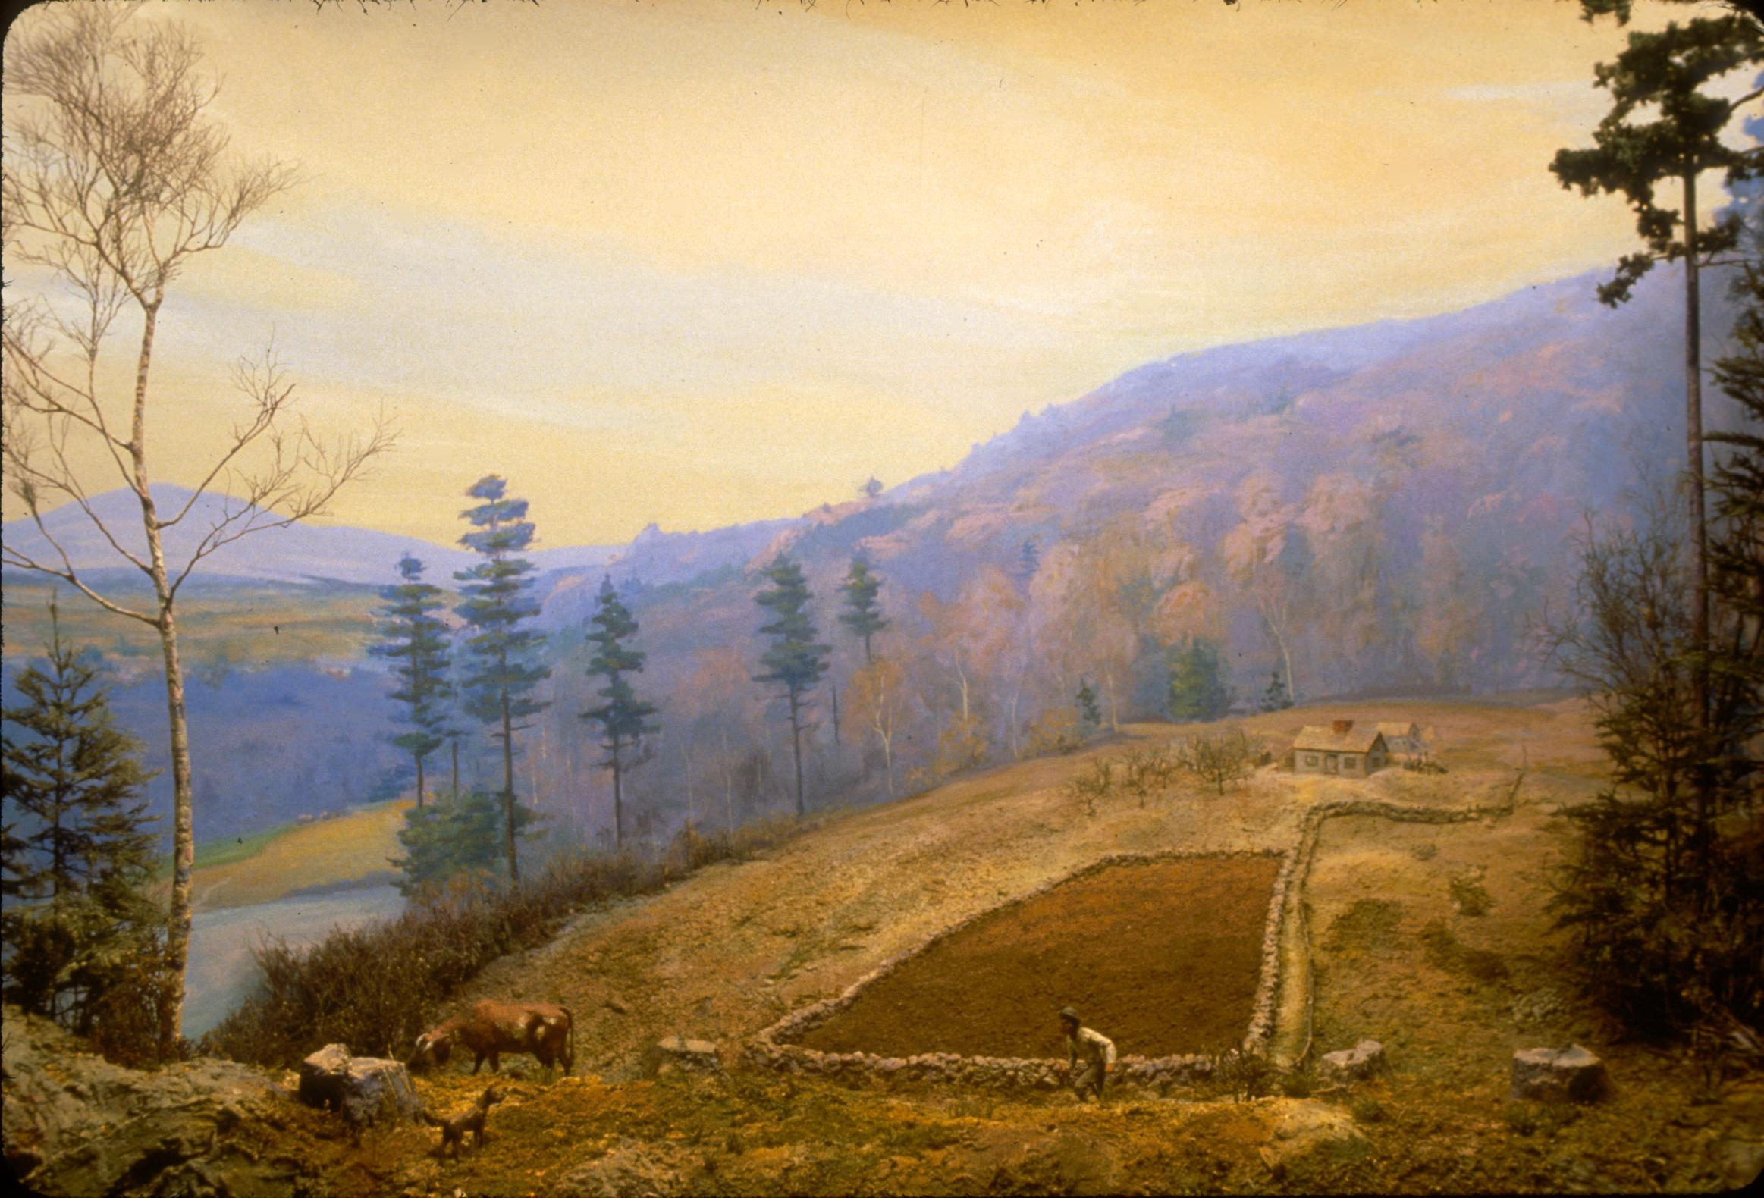
Notes:
Early Settlement, c. 1760s
What do you see in this picture?
What makes you say that?
We see a man building a stone wall around a small plot of dirt.
Recently cut trees
A small log cabin
A tiny barn
A cow or two
A dog
A mountain
A pond
Hilly land
Lots of woods around this tiny clearing
This land, we now call Norwich, was once Abenaki land. The Abenakis came here in the summers near the rivers to fish and then went back north in the winters. There were no buildings like we know today and the land was deep forest. People from Connecticut were struggling to find enough land to farm to feed their large families and looked up to Vermont’s seemingly unoccupied land. They came by canoe each summer to clear the deep forests and build cabins for their families. After they had done this, they brought their families by canoe to begin new lives and build a new town–Norwich.
Fiction books:
Natalie Kinsey Warnock’s: The Bear that Heard Crying –this is a link to a PDF of the book
Diana Appelbaum: Giants in the Land -link to the PDF
Natalie Kinsey Warnock: Wilderness Cat -link to PDF

Slide 4
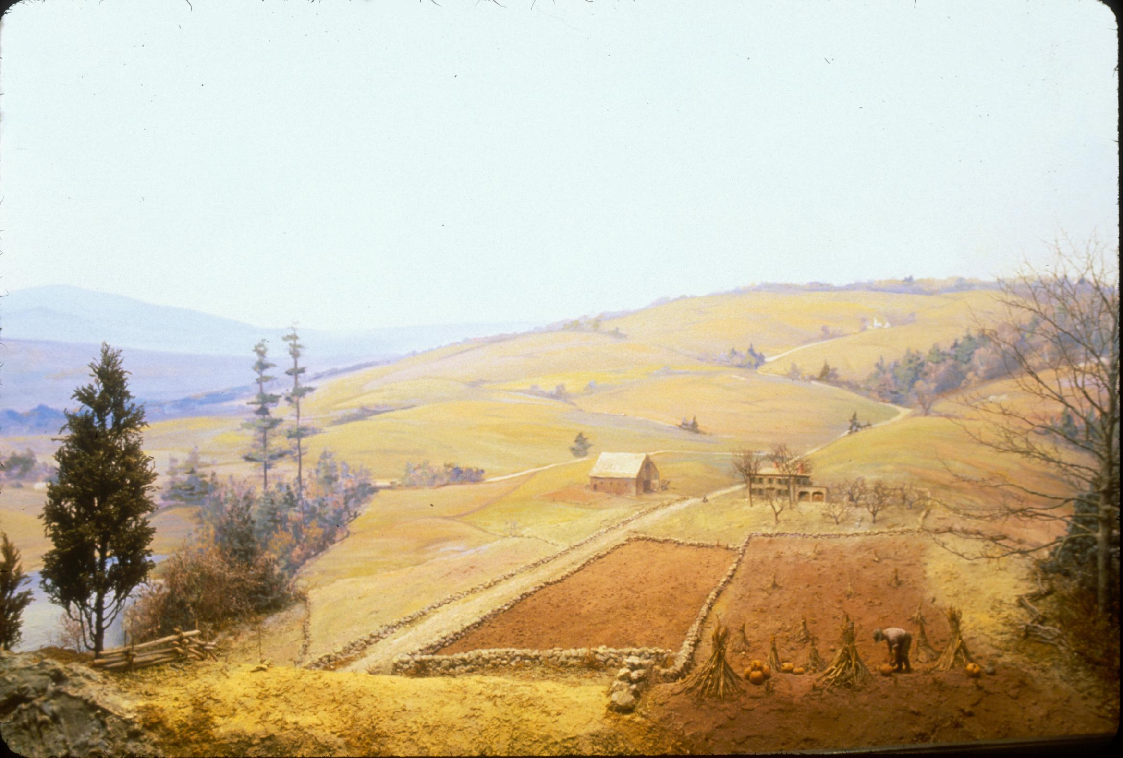
Notes:
Sheep Boom, c. 1830
What do you see?
What makes you say that?
We see the same mountain, rock in lower left corner, pond
Cleared land
Roads
Bigger house
Bigger barn
Double the size clearing
Corn harvested and standing
Pumpkins being Harvested
same time of year –foliage
Look at all the stone walls lining the fields and roads.
Why would the trees be ALL GONE?

Slide 5
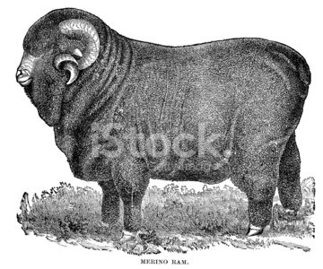
Notes:
Merino sheep brought from Spain by William Jarvis
During this time a man named William Jarvis traveld to Spain. While he was there he saw big sheep with lots of wool. They were climbing up in the hills that looked just like Vermont. They had big teeth to chew touch mountain grass. Jarvis realized that they would be perfect in Vermont. So, he put 100 (or so) sheep on a ship and sailed to Boston. Then he walked all those sheep up from Boston and sold them to farmers all around here. The farmers loved them because all that wool could be spun and woven into cloth and made into clothing. They made a lot of money selling that wool.

Slide 6
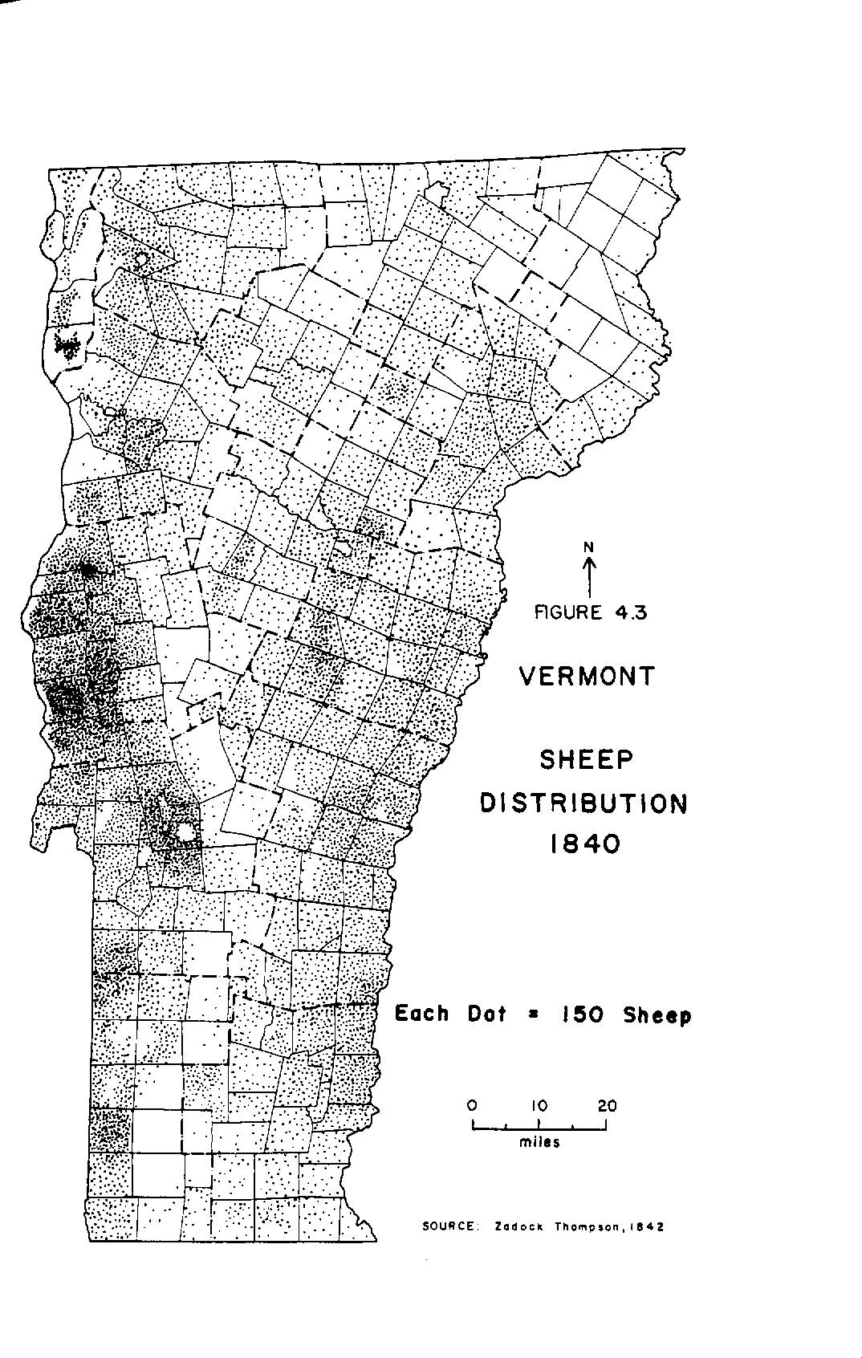
Notes:
Soon there were more sheep than people; 13,000 sheep in Norwich!
What do you think happened when 13,000 sheep needed to eat grass? Trees were cut down, rocks were cleared to the edges of the pastures and made into walls to keep the sheep in, and grass was planted. Soon the land looked like slide #4.
Do you think that was good for the land? Now there were no trees to shade the land. The soil dried out. Rains washed the soil away and down to the streams. The fields lost their soil and became really rocky like we see now up in the hills. Farmers began to have trouble feeding their sheep and growing food for their families. What were they to do?

Slide 7
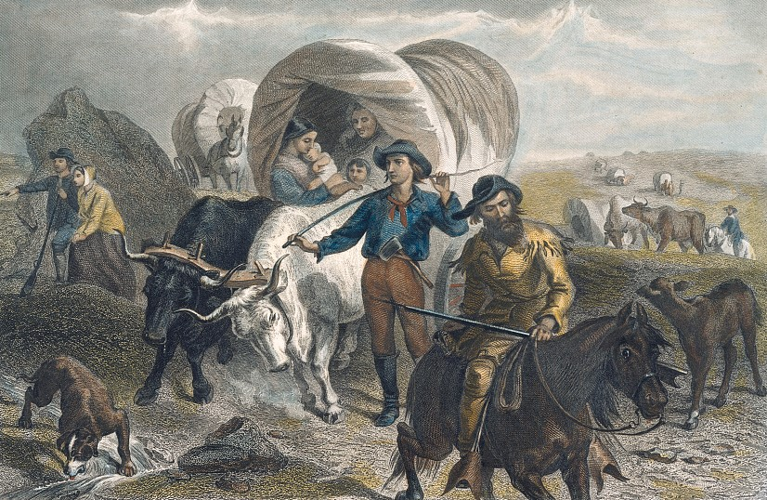
Notes:
Westward Expansion after land depleted by sheep. 1850-1870
They moved to west.
What do you see in this photo?
Lots of people –
Babies –so entire families
Covered wagons
Oxen
cows
horses
little calves
Many, many families left Vermont and began new lives in the West.

Slide 8
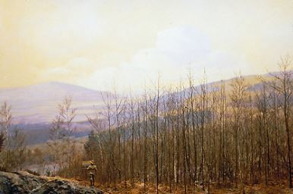
Notes:
Forest Regrowth–ca 1900
What happened to Norwich?
What do you see/
What makes you say that?
There’s the mountain
Pond
Rock in left corner
Many young trees begin to grow and our forests begin to come back so the hills now look like they do today. All those stone walls are still there!

